Slide 1


FOUNDATIONS OF HEALTH DATA SCIENCE
An Introduction for SUND Researchers & Educators

Slide 2
TABLE OF CONTENTS
01
INTRO
04
DATA ANALYSIS
02
DATA COLLECTION
05
MODEL EVALUATION
03
EXPLORATORY DATA ANALYSIS
06
CLOSING REMARKS

Slide 3



Center for Health Data Science (HeaDS)
The mission of the Center is to strengthen health data science within the Faculty:
Active and visible hub for Health Data Science
Providing data science support for research groups at SUND
Courses, workshops and training environments to improve data science skills
Support a network of researchers and educators
Notes:
Before starting the day, I would like to spend 2 minutes to introduce you to the Center for Health Data Science (HeaDS)

Slide 4

WHO ARE WE
Generative modelling
Representation learning
Data Science in Epidemiology
HPC environments
Public and synthetic data,
courses and training
SANDBOX
RESEARCH GROUPS
SUND DATALAB
Courses, Consulting,
Commissions, Supervision

Slide 5
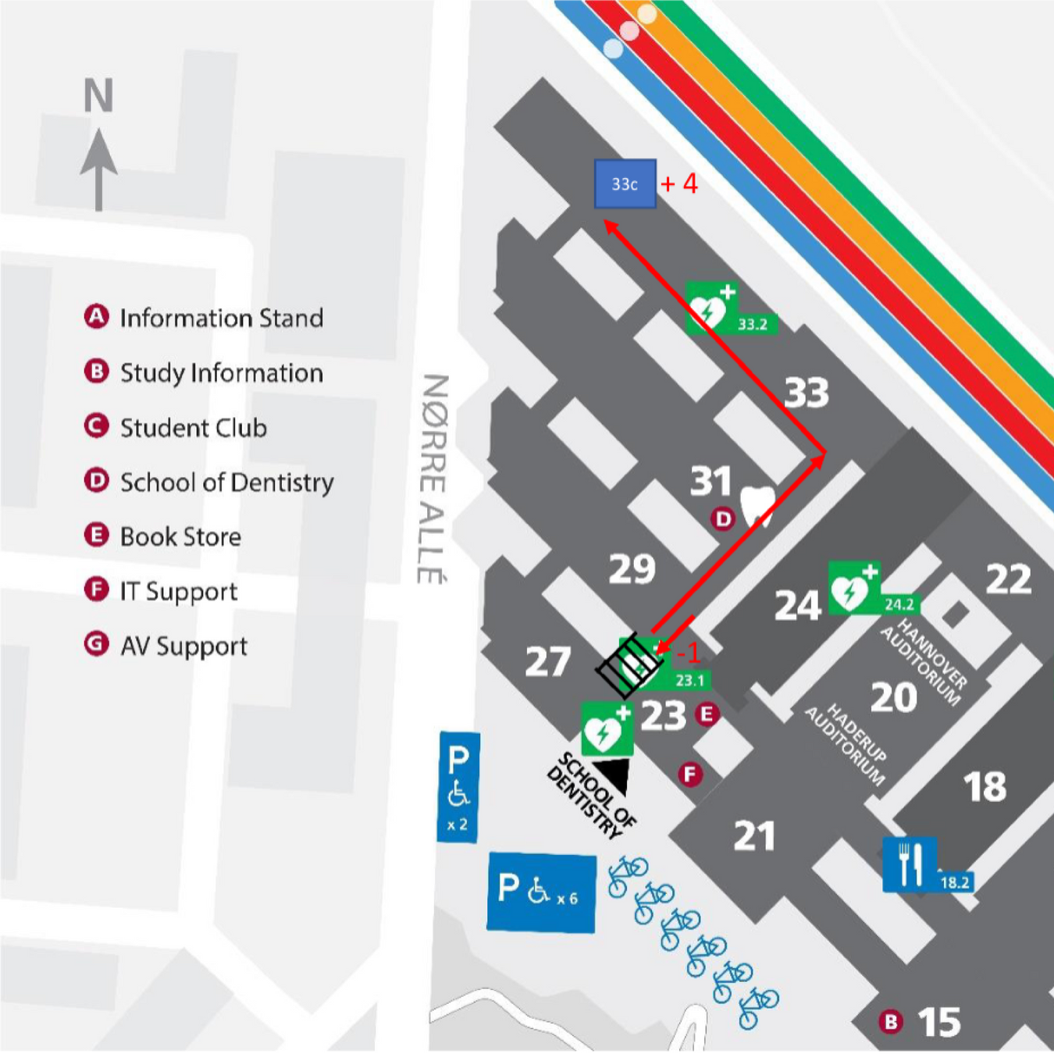

CONTACT US
Email:
heads-admin@sund.ku.dk | datalab@sund.ku.dk
Website:
https://heads.ku.dk/
Location:
Building 33, 4. floor, Section C, Panum

Slide 6
WHAT IS THE DCC
The Digital Core Curriculum (DCC) initiative
KU-wide initiative, started at SUND
Update all educations to include digital literacy and data science competences
Each study board (studienævn) does its own implementation. DCC working group supports and advises
Goal: Implementation of a Digital core curriculum corresponding to 5 – 7,5 ECTs per study line
Notes:
Started in 2019 at SUND by vice dean of education Hans Henrik Saxild
Then taken up by KU board of directors and implemented KU wide
Sund is 1 year ahead of the rest of the faculties in the process. Some departments and institutes are further in the process than others.
The 5 – 7,5 ECTS can be one or two new, specific courses or DCC can be integrated into existing courses
Future-proof educations at KU by adding digital competences, also in the formal learning objectives and give graduates the skills they need to succeed in research careers as well as the job market

Slide 7


THE PURPOSE OF THIS COURSE
In this course, we are going to begin our journey into Data Science
What is (Health) Data Science (DS)? Roles, definitions, data types
A Data’s journey: What happens from data collection to scientific results?
Data science is not scary nor mystical. Now you know the 'fancy words'
Where to find useful data science analysis, tools and courses
Inspiration for incorporation of DS and/or the DS mindset into teaching
Notes:
What is this course not?
Not about generative AI (no ChatGPT, DallE2, ect)

Slide 8

In this course, we are going to begin our journey into Data Science.
On our way we shall touch upon data collection, exploration, analysis and evaluation.
DATA COLLECTION
EXPLORATORY DATA ANALYSIS
DATA ANALYSIS
MODEL EVALUATION
Notes:
Data collection and access
Maybe validation?
Overfitting
Bias, confidence (interval)

Slide 9

During the course we will use Mentimeter for feedback and discussion.
Let’s try it out!

Slide 10
Now that you know about HeaDS and this course, we want to hear some things about you.

Slide 11

WHAT IS DATA SCIENCE?

Slide 12
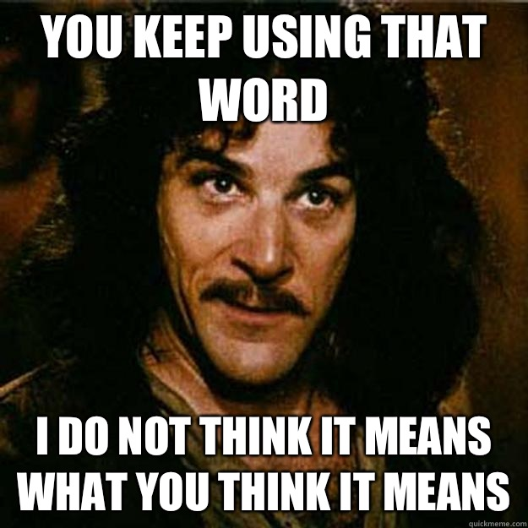
WHAT DO THE WORDS MEAN?
We often hear the words Data Science, Machine Learning and AI used together, sometimes as if they were synonyms.
Buuuut, they are not :)
Let's try some differentiation.
Notes:
ML is more about development of tools that enable computer to do these human-like performances
DS is more about everything related to data

Slide 13
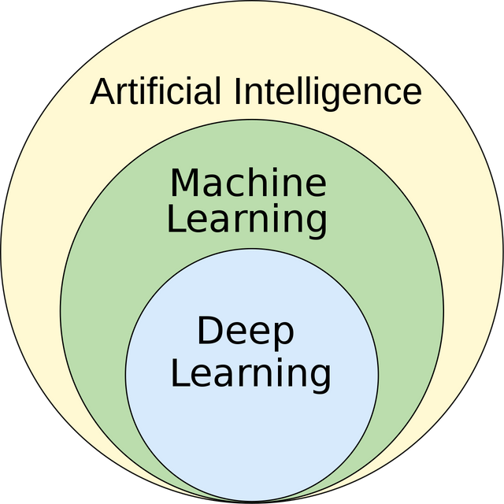
WHAT DO THE WORDS MEAN?
Notes:
ML is more about development of tools that enable computer to do these human-like performances
DS is more about everything related to data

Slide 14
WHAT DO THE WORDS MEAN?
Artificial Intelligence:
The ability of computing systems to achieve human-like performance on complex tasks
Conceptual umbrella term
AI is the outcome, not the method
Notes:
ML is more about development of tools that enable computer to do these human-like performances
DS is more about everything related to data

Slide 15
WHAT DO THE WORDS MEAN?
Machine Learning:
"Technologies and algorithms that enable systems to identify patterns, make decisions, and improve themselves through experience and data" [1]
Machine learning is methodology.
Currently our most successful way of achieving AI
1. https://ai.engineering.columbia.edu/ai-vs-machine-learning/
Notes:
ML is more about development of tools that enable computer to do these human-like performances
DS is more about everything related to data

Slide 16
WHAT DO THE WORDS MEAN?
Deep Learning:
When you do ML by means of a deep neural network
This is a type of/sub-class of (ML).
Data science is often taken to mean ML/AI, but the term is much broader than that!
…and this is not a course on ML/AI.
Notes:
ML is more about development of tools that enable computer to do these human-like performances
DS is more about everything related to data

Slide 17
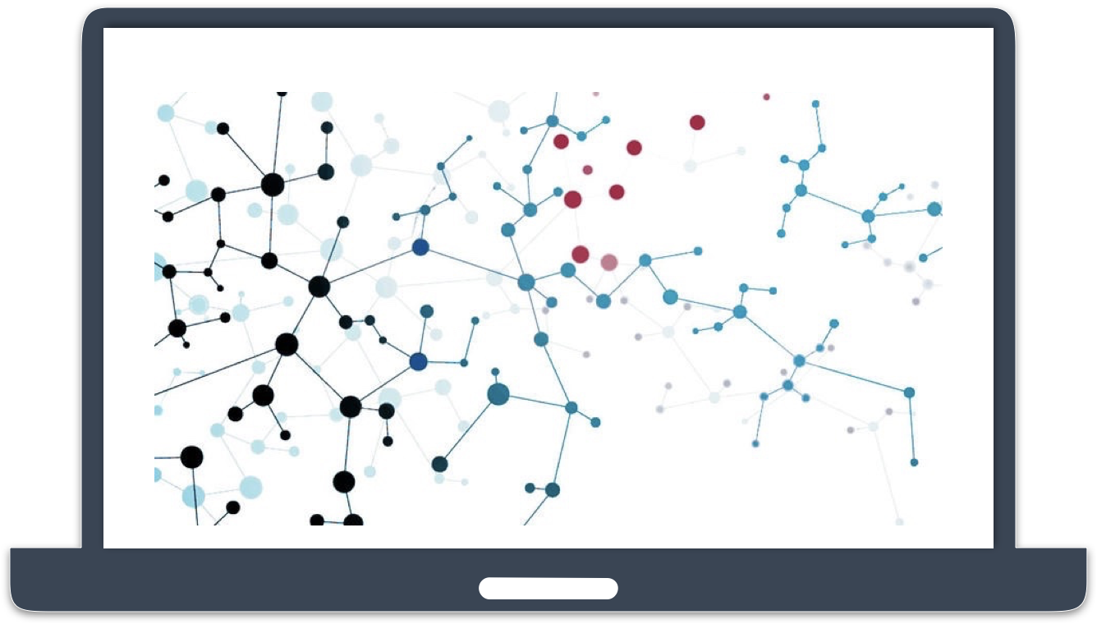
WHAT IS DATA SCIENCE?
Data Science combines math, statistics, programming and algorithms with domain expertise in order to extract insights from data.
- IBM
Data Science is the processing of data with the goal to learn something about its characteristics or answer a question.
- HeaDS

Slide 18

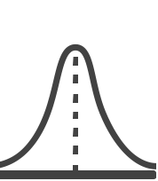
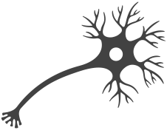
WHAT IS DATA SCIENCE?
Data Science is an umbrella term.
A cross-disciplinary undertaking that draws on many disciplines and is in turn becoming part of many disciplines.
Data matters, one size analysis does not fit all.
In Helath Data Science the Domains are
PROGRAMMING
ML/AI
DATA
SCIENCE
MATH & STATISTICS
DOMAIN KNOWLEDGE

Slide 19

WHY DO WE WORK WITH DATA?
To extract knowledge about how the world works and, if possible, make generalizations and predictions.
Data Science is the more formalized process where we make use of tools such as computers and algorithms to help us make sense of vast amounts data.

Slide 20
ROLES
Not everybody is involved in every step.
Data Collector:
Produces or gives access to the data. Often has domain knowledge on the data, i.e. doctors working at the hospital
Statistician/Mathematician:
Selects the appropriate tests and/or models
May do the data analysis
Principal Investigator:
Introduces the research question

Slide 21
ROLES
Data Scientist (Computer Scientist/ Bioinformatician)
Does the data wrangling, cleaning and pre-processing
Does the data analysis
May standardize and/or implement as software
Visualisations expert:
Makes the plots to illustrate results
Selects proper type of plot
Focus on interpretability and accessibility
Domain expert:
Sparring about results
Biological/clinical relevance
Article author

Slide 22

WHAT IS HEALTH DATA SCIENCE?
In Health Data Science the domains of interest are medicine (micro)biology, biochemistry, etc.
PROGRAMMING
Field is concerned with:
Biological mechanisms central to disease development
Discovery and assessment of disease specific drug treatment
Disease progression and patient survival
Personalized medicine
ML/AI
DATA
SCIENCE
MATH & STATISTICS
MEDICINE
BIOLOGY

Slide 23
After this brief intro, how do you see the importance of data science to you personally?

Slide 24

GROUP DISCUSSION
Which of the roles we have introduced do you see yourself in?
Do you have people in your group or among your collaborators to fill the other roles? If not, what are the alternatives?
Notes:
What kind of data types do you and your collaborators work with?
What would you like to work with?
Which of the roles we have introduced do you see yourself in?
Do you have people in your group or among your collaborators to fill the other roles? If not, what are alternatives?

